Slide 1


M.Tech/MCA Program
Advanced Industry Integrated Programs
Jointly offered by University and LTIMindTree
Review III
PROCURE BOT
Intelligent Procurement & Vendor Q&A Assistant
Syed Ali Fathima S
M.TECH(AI&DS)|B.S.A.CRESCENT INSTITUTE OF SCIENCE AND TECHNOLOGY|T9957
Knowledge partner | Implementation partner

Slide 2
Project Title - Procure bot
Introduction
• Procurement teams work with heterogeneous information such as purchase orders, vendor contracts, invoices, compliance rules and supplier records.
• Manual searching across documents and tables makes procurement Q&A, compliance checks and supplier analysis time-consuming.
• Procure Bot combines Retrieval-Augmented Generation (RAG), metadata-aware retrieval and a local LLM to provide grounded procurement assistance.
• The platform uses a React frontend and FastAPI backend with vector retrieval through FAISS/Qdrant and Ollama-based language models.
• The system is designed to support procurement decisions while keeping responses connected to the organization's available procurement knowledge.

Slide 3
Project Title - Procure bot
Objective
• Develop an AI-powered procurement assistant for natural-language procurement queries.
• Build a RAG pipeline for retrieving relevant information from structured and unstructured procurement data.
• Provide procurement Q&A for purchase orders, vendors, contracts, invoices and policies.
• Implement a compliance checker that compares procurement information against defined rules and policies.
• Support supplier analysis and generate RFQ-related drafts to accelerate sourcing workflows.
• Provide an interactive enterprise-style web interface using React with a FastAPI service layer.Use a local LLM through Ollama to support domain-focused, data-grounded responses.

Slide 4
Project Title - Procure bot
Module name
1. User & Dashboard
2. Document / Data Ingestion
Procurement workspace, navigation and natural-language interaction.
Process PO tables, contracts, invoices, supplier data and compliance rules.
3. Preprocessing & Chunking
4. Embedding & Vector Store
Clean content, create chunks and attach metadata for retrieval.
Generate embeddings and store searchable vectors using FAISS/Qdrant.
5. Hybrid RAG Q&A
6. Compliance Checker
Retrieve relevant context using semantic retrieval and metadata filtering.
Evaluate procurement records against compliance and policy rules.
7. Supplier Analysis
8. RFQ Assistant
Summarize vendor information and support supplier comparison.
Generate structured RFQ-related content from procurement requirements.
Procure Bot | Review III
4

Slide 5
Project Title - Procure bot
Problem Statement
• Procurement information is distributed across spreadsheets, purchase orders, contracts, invoices and policy documents.
• Traditional keyword search may miss semantically relevant information and requires users to know where the information is stored.
• Procurement staff need faster answers about PO status, supplier details, policy requirements and compliance conditions.
• Manual compliance verification can be repetitive and difficult when multiple rules and documents must be considered.
• RFQ preparation and supplier analysis require combining information from different sources.
• Therefore, there is a need for a domain-focused procurement assistant that combines structured data, document retrieval, policy checks and generative AI.

Slide 6
Project Title - Procure bot
Methodology
1. User Query
Question / procurement request
2. FastAPI Routing
API receives and routes the request
3. Query Processing
Identify procurement intent and retrieval needs
4. Knowledge Retrieval
Search vectors + metadata-filtered records
5. Context Formation
Build grounded context from relevant sources
6. LLM Generation
Ollama / Llama 3 generates the response
7. Business Logic
Compliance, supplier or RFQ processing
8. Response
Structured result returned to React
Procure Bot | Review III
6

Slide 7
Technology Stack
Stage | Technology | Role
1. User Interface | React + JSX | User enters procurement questions and interacts with the dashboard
2. UI Design | Tailwind CSS | Provides enterprise-style dashboard and components
3. API Communication | JavaScript fetch / HTTP | Sends requests from React to FastAPI
4. Backend | FastAPI + Python | Receives requests and executes business logic
5. Data Processing | Pandas | Reads, cleans and analyses procurement data
6. Query Processing | Python | Processes the user's procurement question
7. Query Embedding | Nomic Embed Text | Converts the question into a 768-dimensional vector
8. Vector Retrieval | Qdrant | Searches for relevant procurement records
9. Similarity | Cosine Similarity | Measures semantic similarity
10. Hybrid Retrieval | LlamaIndex + structured filtering | Combines semantic and metadata/structured retrieval
11. Context Formation | Python / LlamaIndex | Prepares retrieved procurement information as context
12. LLM | Llama 3.1 8B | Understands context and generates answer
13. Local Runtime | Ollama | Runs Llama locally
14. Business Logic | Python | Compliance, supplier, PO, RFQ and procurement operations
15. Response | FastAPI → React | Sends generated result back to frontend
16. Visualization | React + Tailwind CSS | Displays answer, KPIs, tables and analytics

Slide 8
Project Title - Procure bot
Algorithms
1. Data Ingestion
Load procurement CSV/tables and process supported procurement documents.
2. Cleaning & Normalization
Normalize fields, remove noise and prepare consistent records.
3. Chunking
Split long textual content into retrieval-friendly chunks.
4. Metadata Extraction
Attach identifiers such as PO/vendor/category/document metadata.
5. Embedding Generation
Convert text chunks into vector representations using an embedding model.
6. Vector Indexing
Store embeddings for efficient semantic retrieval in FAISS/Qdrant.
Procure Bot | Review III
7

Slide 9
Algorithms
RAG, business logic and response generation
7. Hybrid Retrieval
8. Context Formation
Combine semantic similarity with metadata-aware filtering to identify relevant procurement context.
Assemble retrieved records/documents into a controlled prompt context.
9. Generative AI Processing
10. Compliance Evaluation
Use Ollama-hosted Llama 3 to generate a domain-focused response.
Compare relevant procurement details against configured compliance rules.
11. RFQ / Supplier Processing
12. Grounded Response
Generate RFQ drafts and supplier-focused summaries from retrieved context.
Return the answer and supporting procurement context to the React interface.
Procure Bot | Review III
8

Slide 10
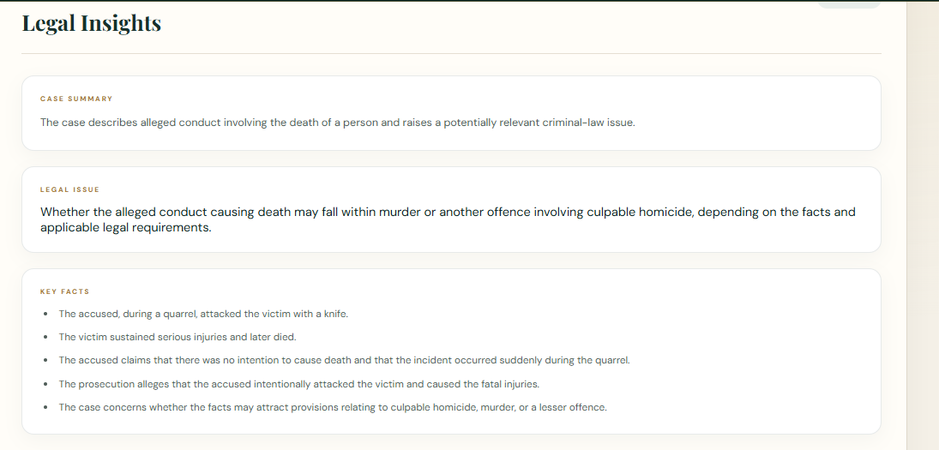
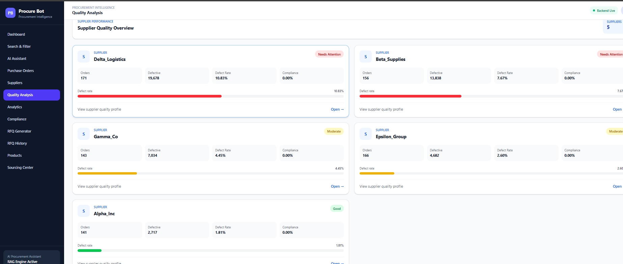
Project Title - Procure bot
Findings and Results

Slide 11
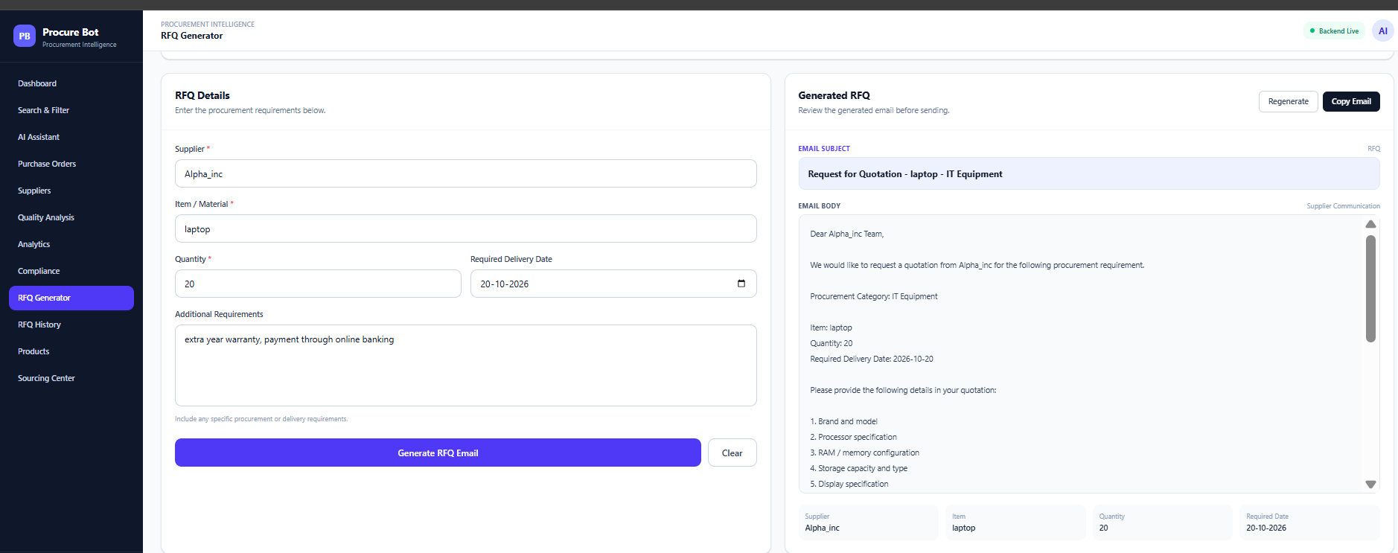
Project Title - Procure bot
Findings and Results

Slide 12
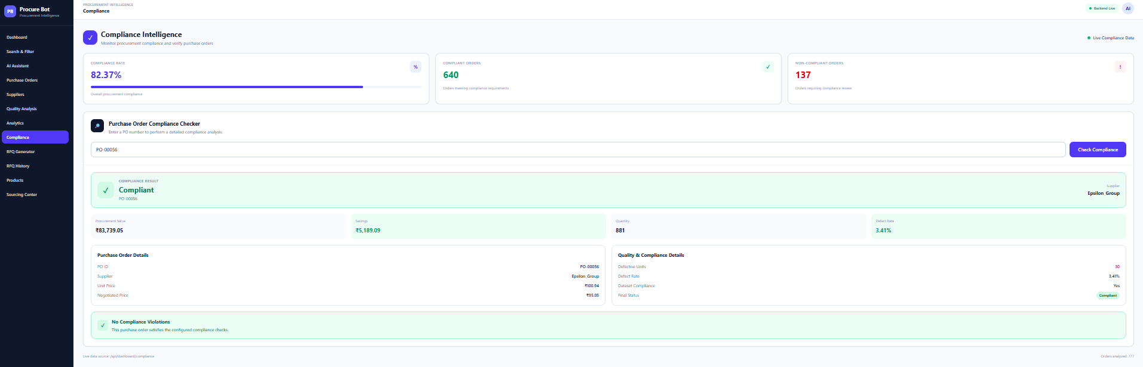
Project Title - Procure bot
Findings and Results

Slide 13
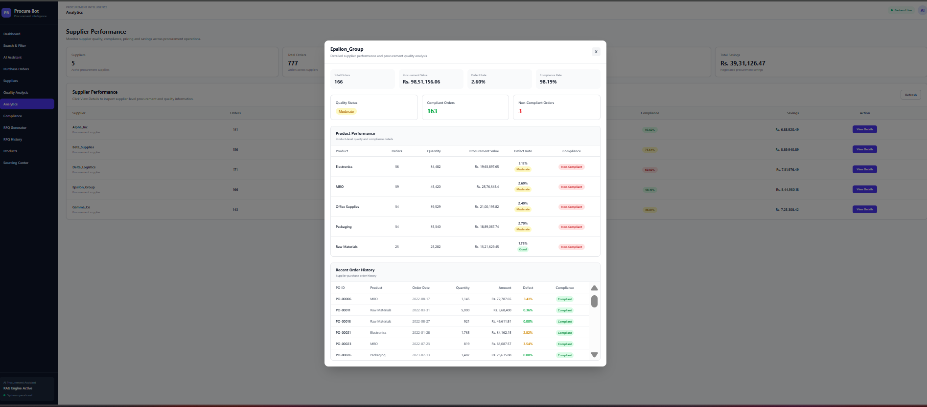
Findings and Results

Slide 14
Limitations & Future Work
Limitations | Future Work
Limited procurement dataset | Real-time ERP integration
Data quality dependency | Advanced hybrid RAG + reranking
Local LLM latency | Cloud/scalable deployment
Retrieval-dependent responses | Source citations & explainability
Basic compliance rules | Configurable compliance engine
Prototype-level security | Authentication & RBAC
No real-time enterprise integration | Automated supplier risk analysis

Slide 15
Project Title - Procure bot
Conclusion
Procure Bot provides an intelligent procurement assistance layer by combining procurement data, Retrieval-Augmented Generation, vector search and a local large language model. The platform is designed to reduce the effort required to locate procurement information and to support practical workflows such as PO Q&A, compliance checking, supplier analysis and RFQ drafting. The React frontend and FastAPI backend provide a modular foundation for extending the system into a complete procurement workspace. The updated dashboard direction further improves the product experience by presenting procurement KPIs, analytics, quick actions and recent activity in an enterprise-oriented interface.

Slide 16
Project Title - Procure bot
Acknowledgement
I sincerely thank LTM and L&T EduTech for providing the infrastructure, laptop, training room, ID card, and a valuable 2-month opportunity to enhance my technical skills through practical project development.
I express my special gratitude to Dr. Ganesh for his continuous guidance, valuable suggestions, and support in improving my project. I also thank the Classroom Managers for their daily monitoring, coordination, and assistance in resolving issues. Finally, my special thanks to Mr. Jayakanthan, Manager – Delivery Operations, L&T EduTech, for his encouragement, support, and for providing this valuable opportunity.

Slide 17
Project Title - Procure bot
Reference
[1] Guida, M., Caniato, F., Moretto, A., & Ronchi, S. (2023). The role of artificial intelligence in the procurement process: State of the art and research agenda. Journal of Purchasing and Supply Management, 29(2), 100823. DOI: 10.1016/j.pursup.2023.100823.
[2] Spreitzenbarth, J. M., Bode, C., & Stuckenschmidt, H. (2024). Artificial intelligence and machine learning in purchasing and supply management: A mixed-methods review of the state-of-the-art in literature and practice. Journal of Purchasing and Supply Management, 30(1), 100896.
[3] Brandtner, P., & Hofer, F. (2026). Enhancing Procurement Processes in Supply Chain Management with Large Language Models. Procedia Computer Science, 278, 308–315. DOI: 10.1016/j.procs.2026.02.467.
[4] Joshi, A., Singh, M., Parashar, D., et al. (2026). A multi-agent large language model framework for intelligent vendor evaluation and risk-aware procurement decisions. Scientific Reports, 16, 19826. DOI: 10.1038/s41598-026-50952-x.

